Slide 1
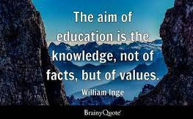
The Lady Byron School
Values

Slide 2
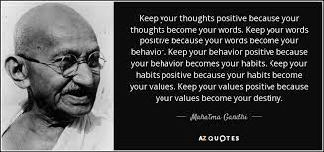
What are values?
Values are individual beliefs that motivate people to act one way or another. They serve as a guide for human behaviour.

Slide 3
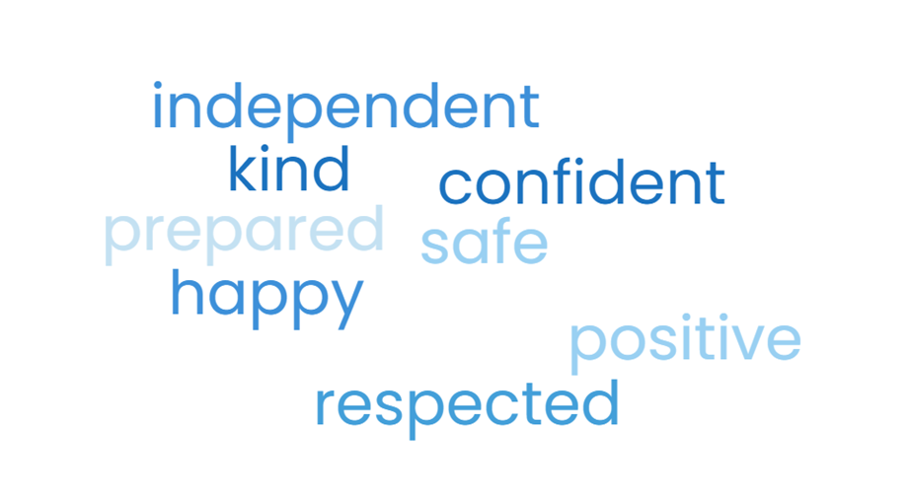
The Lady Byron School Values
Top words mentioned from survey of parents, students and staff

Slide 4
How can we demonstrate our values in our behaviour?

Slide 5
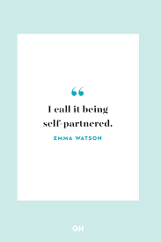
Independent
Staff behaviours
Being proactive
self-directed
Focused
goal-oriented
Taking the initiative rather than waiting to be told what to do
Student behaviours
self-aware
self-monitoring
self-correcting
Doing what is asked to the best of your ability
working until the job is completed

Slide 6
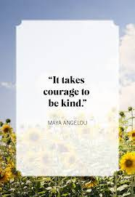
Kind
Staff behaviours
Assume the best.
Don’t cast others in a negative light
Listen and value other people’s ideas
Keep your promises
Student behaviours
Make someone laugh
Tell someone you are proud of them
Pick up some rubbish and put it in the bin
Help someone else

Slide 7
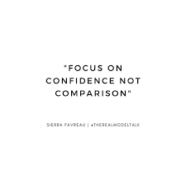
Confident
Staff behaviours
Feeling sure of yourself and your abilities as a member of staff
Give opportunities for students to demonstrate confident behaviours
Be positive about yourself and others
Encourage – you can do this
Acknowledge mistakes
Student behaviours
Step out of your comfort zone.
Focus on being the best version of yourself.
Check something off your to-do list.
Stop the negative self-talk.
Feel worthy of good things
Be compassionate with self and others

Slide 8
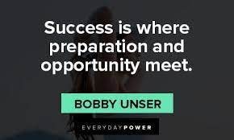
Prepared (for adult life)
Staff behaviours
Provide real world experiences
Explore opportunities that are relevant now and, in the future
Talk about own experiences
What next – encourage discussion about the future:
- Education and employment - Good Health
- Independent living - Community & Relationships
Student behaviours
What next? Think about what you want
Talk to adults about how they can support you
Practice the skills you need
Learn new skills
- managing money & time -personal care
- Travelling independently -domestic skills

Slide 9
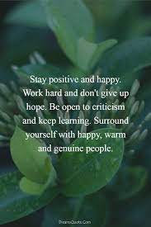
Positive
Staff behaviours
Seeing the good in others
Be optimistic and enthusiastic (even if you don’t feel it!)
Have integrity
Be mindful of others thoughts and feelings
Student behaviours
Allow others to learn
Show gratitude
Accept difference
Make a positive comment about yourself and others
Think positive and have a go

Slide 10
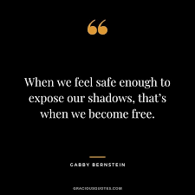
Safe
Staff behaviours
Reassure students
Build communicative relationships
Anticipate possible problems
Protect your own mental health
Student behaviours
Staying healthy
Protecting yourself emotionally and physically
Communicate what makes you feel safe
Establish boundaries

Slide 11
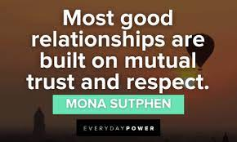
Respect (student choice of word)
Staff behaviours
Avoid gossip and any conversations that may be considered discriminatory or bullying.
Understand everyone has their own experiences and beliefs
Speak up if others around you are being disrespectful
Be willing to evolve and admit mistakes
Think before you speak, your language and tone
Student behaviours
Be kind and courteous.
Be polite, avoid interrupting or causing disturbances.
Listen to others and respect differences in beliefs and opinions.
Think before you speak
Respect personal space and personal property

Slide 12
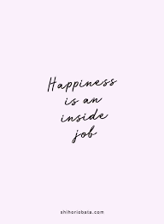
Happy
Staff behaviours
Being open to new ideas and experiences
Wanting to share your happiness and joy with others
Feeling positive more than negative
Enjoying positive, healthy relationships with other people
Student behaviours
Enjoying positive, healthy relationships with other people
Feeling that you have accomplished (or will accomplish) what you want in life
Feeling positive more than negative
Being open to new ideas and experiences
Practicing self-care and treating yourself with kindness and compassion

Slide 13
LBS Values and British Values
British Values
democracy.
the rule of law.
individual liberty.
mutual respect and tolerance of those with different faiths and beliefs.

Slide 14
Everything we do goes back to our values

Slide 15
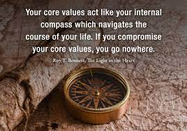
Being held accountable
Student Accountability
Is that behaviour showing respect?
Are you being kind?
Does that help you become independent?
That shows you are confident
Doing that is keeping you safe
Thank you for being positive
You look like you are happy
Staff Accountability
Performance management
Responsibility for Actions / behaviour
Modelling to students
Consequences

Slide 16
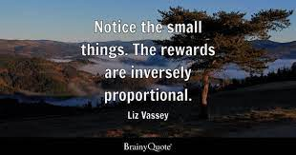
Rewarding Values
Raffle Tickets
Shout Outs
Values display with examples of staff and students
Additional opportunities for staff and students
Assemblies
Postcards home
Certificates (Mel made already)

Slide 17
Key Messages
How we behave always needs to come back to our LBS values
Whatever decisions we make needs to promote LBS values
Staff and students need to demonstrate the values
Staff and students will be held accountable
LBS values need to become everyday language
We can relate the values to British Standards

Slide 18
The Lady Byron School Values

Slide 19
LBS Values Becoming Independent
We
are self-aware
are self-monitoring
are self-correcting
do what is asked to the best of our ability
work until the job is completed

Slide 20
LBS Values Being Kind
We
can make someone laugh
tell someone we are proud of them
can pick up some rubbish and put it in the bin
can help someone else

Slide 21
LBS Values Being Confident
We
can step out of our comfort zone.
can focus on being the best version of ourselves.
can check something off our to-do list.
can stop the negative self-talk.
feel worthy of good things
be compassionate with ourself and others

Slide 22
LBS Values Being Prepared
We
think about what we want in life
talk to adults about how they can support us
practice the skills we need for adult life
learn new skills we need for adult life

Slide 23
LBS Values Feeling Safe
We
work on staying healthy
protect ourself emotionally and physically
communicate what makes us feel safe
establish our boundaries

Slide 24
LBS Values Feeling Happy
We
Enjoy positive, healthy relationships with other people
Feel that we have accomplished (or will accomplish) what we want in life
feel positive more than negative
are open to new ideas and experiences
practice self-care and treat ourself with kindness and compassion

Slide 25
LBS Values Feeling Positive
We
allow others to learn
show gratitude
accept difference
make positive comments about ourself and others
think positive and have a go

Slide 26
LBS Values Showing Respect
We
are kind and courteous.
are polite, avoid interrupting or causing disturbances.
listen to others and respect differences in beliefs and opinions.
think before we speak
respect personal space and personal property

